Slide 1

01
02
03
04
05
06
PROGRESS UPDATE
LOOK AHEAD ACTIVITIES
PROGRESS CHART
BUDGET & INVOICING
SCHEDULE
Q&A
JSBC Meeting
December 10, 2024
TONIGHTS AGENDA
Notes:
David’s slide

Slide 2
Activities completed within the last 30-days
Continued modular punch list
Closeout of Consigli Mod contract (binders received)
Closeout of Triumph Modular contract (binders received)
Coordination and installation of technology
CM contract for Group 1 in progress [Consigli]
CM contract for Group 2 in progress [Harvey]
CM contract Beech in progress [Harvey]
Pre-construction mtgs for Group 1
Pre-construction mtgs for Beech
Continued development of the various Project schedules
Progression into construction documents for Hillside & McLaughlin
Continued Beech Elementary programming
Attendance at BOMA Mtg.
Development of P1 website
Continued communication with all stakeholders
Established Survey Baseline Scope for culvert at Sheridan-Emmett Park
30-Day Look-Ahead
Complete modular punch list
MEP Training for modular equipment
Continued closeout of Consigli for Mod contract
Continued closeout of Triumph Modular contract
Execute CM contract for Group 1 [Consigli]
Execute CM contract for Group 2 [Harvey]
Execute CM contract for Beech [Harvey]
Continued pre-construction mtgs for Group 1
Reevaluate Beech Street School Options
Continued development of the various Project schedules and coordination of construction phasing for Hillside & McLaughlin [Group 1]
Exploratory work at Hillside & McLaughlin
Continued Beech Street budget refinement
Development of P1 website (continued)
Continued communication with all stakeholders
Survey of culvert at Sheridan-Emmett Park
PROJECT PROGRESS
Notes:
Lynn’s slide

Slide 3
PROGRESS UPDATE
Priority 1 Projects | Update Summary
Notes:
Lynn’s slide

Slide 4
PROGRESS UPDATE
Modulars Summary Update
The punch list is 98% complete and will continue over the next month. Additionally, there will be some punch list scope that will be addressed during winter break
Notes:
Lynn’s slide

Slide 5
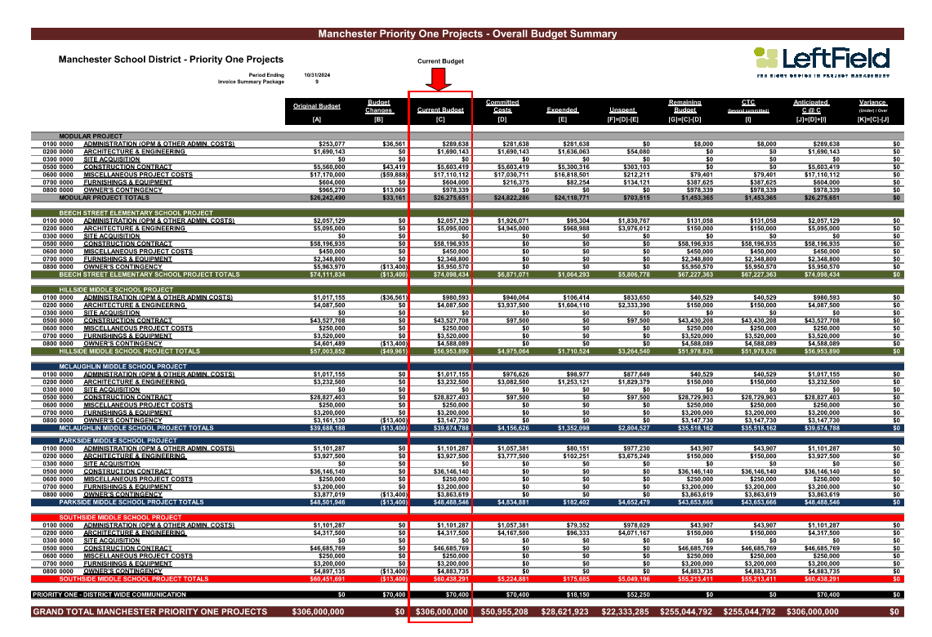
BUDGET STATUS
Notes:
Lynn’s slide

Slide 6
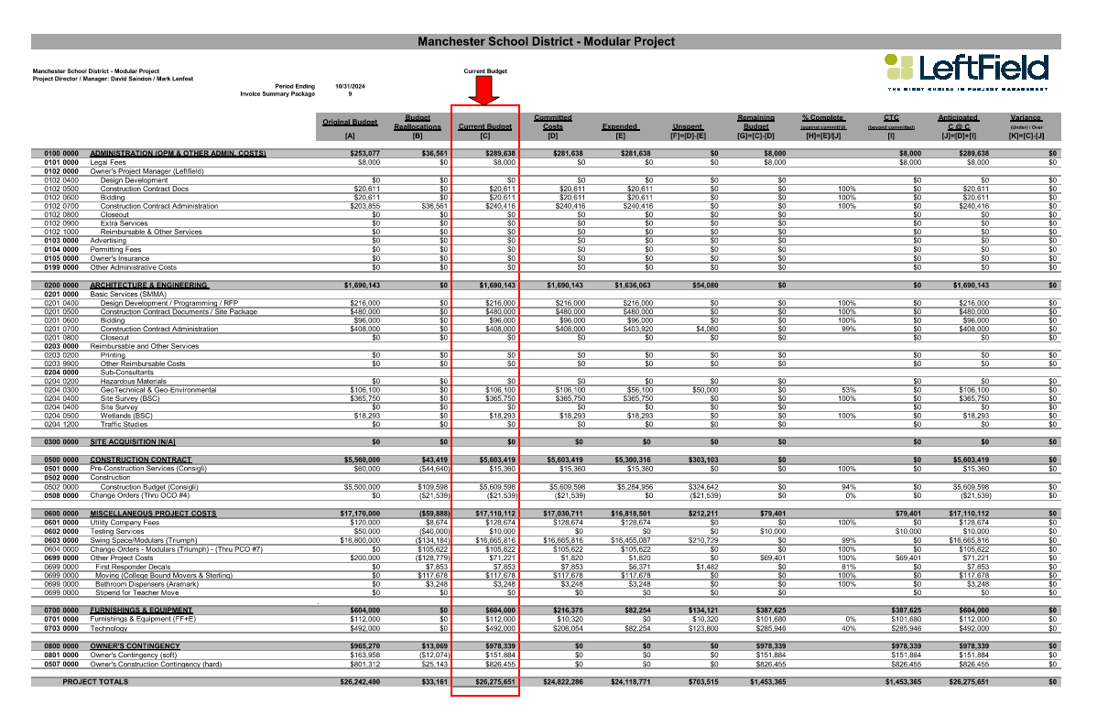
DRAFT
BUDGET STATUS – MOD PROJECT
Notes:
Lynn’s slide

Slide 7
Invoice Summary for Period Ending November 2024
INVOICE UPDATE
Please note that due to the timing of the JSBC meeting, warrant signing coordination and invoice due dates, an invoice log will NOT be attached to this monthly report.
Notes:
Lynn’s slide

Slide 8
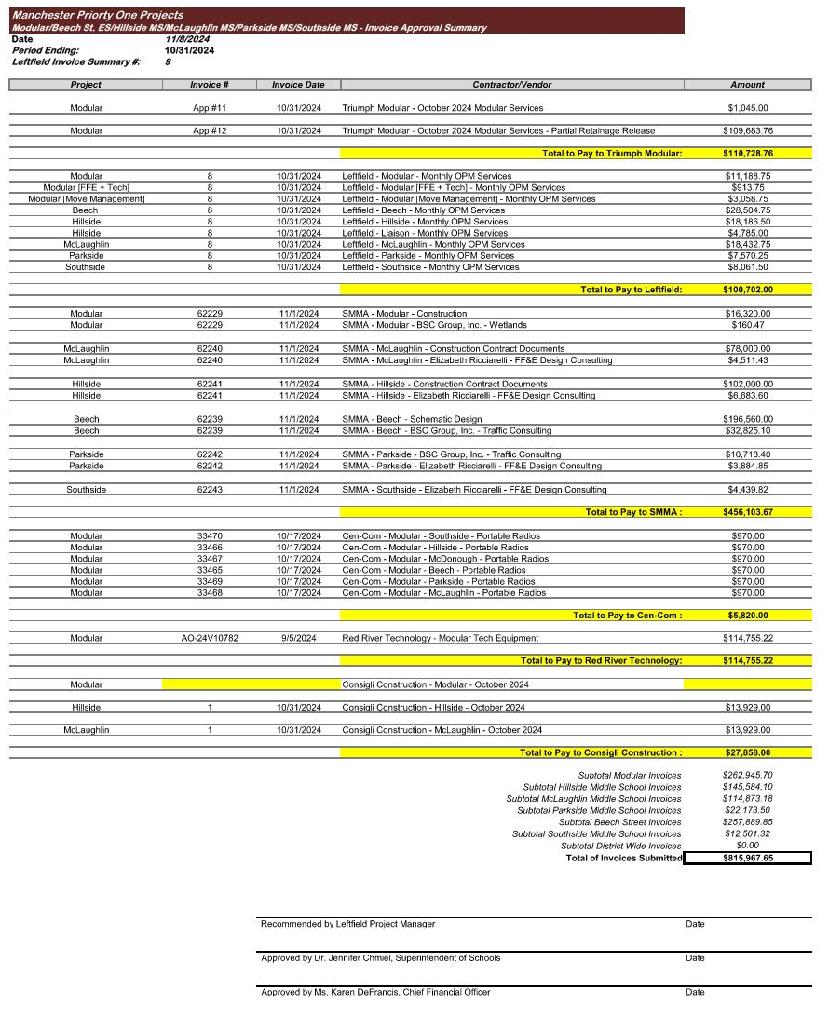
The invoice payment log is scheduled for District approval on December 13th and payment approval on December 19th, with the payment check date for December 20th.
The invoice log presented here will be approved by the District on December 13, 2024.
INVOICE UPDATE
DRAFT
Notes:
Lynn’s slide

Slide 9
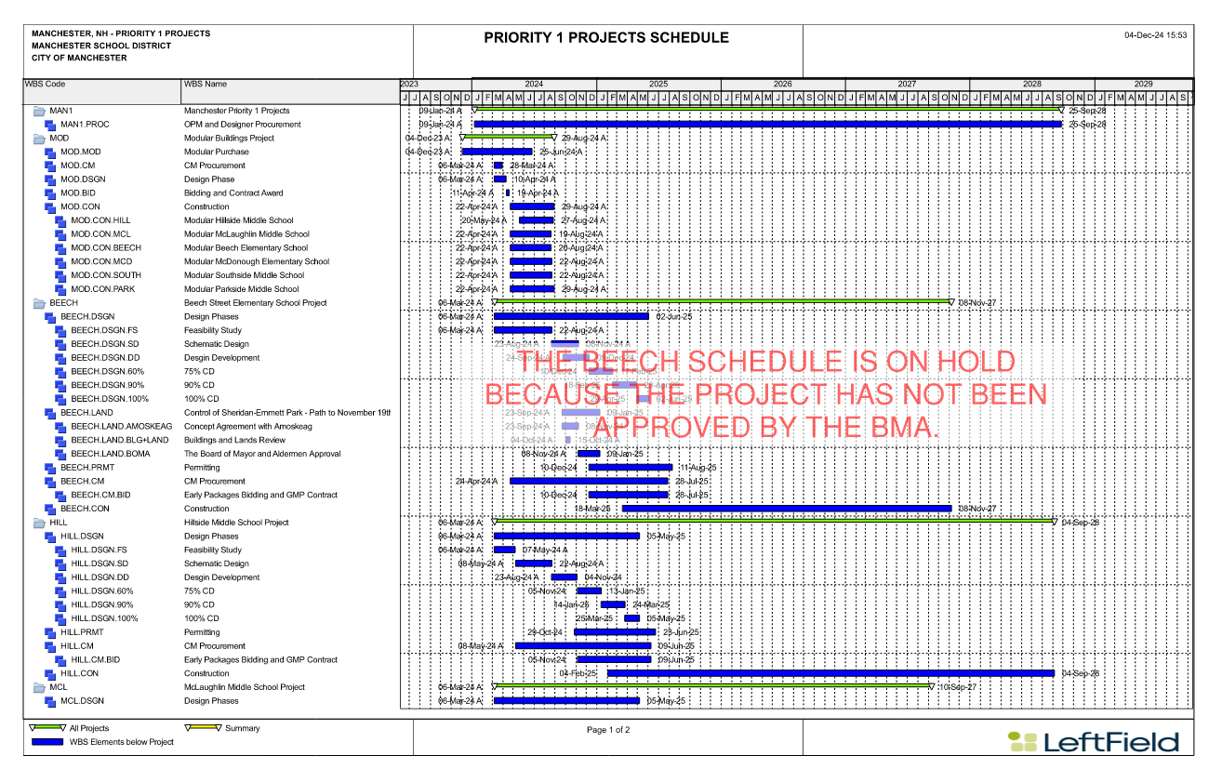
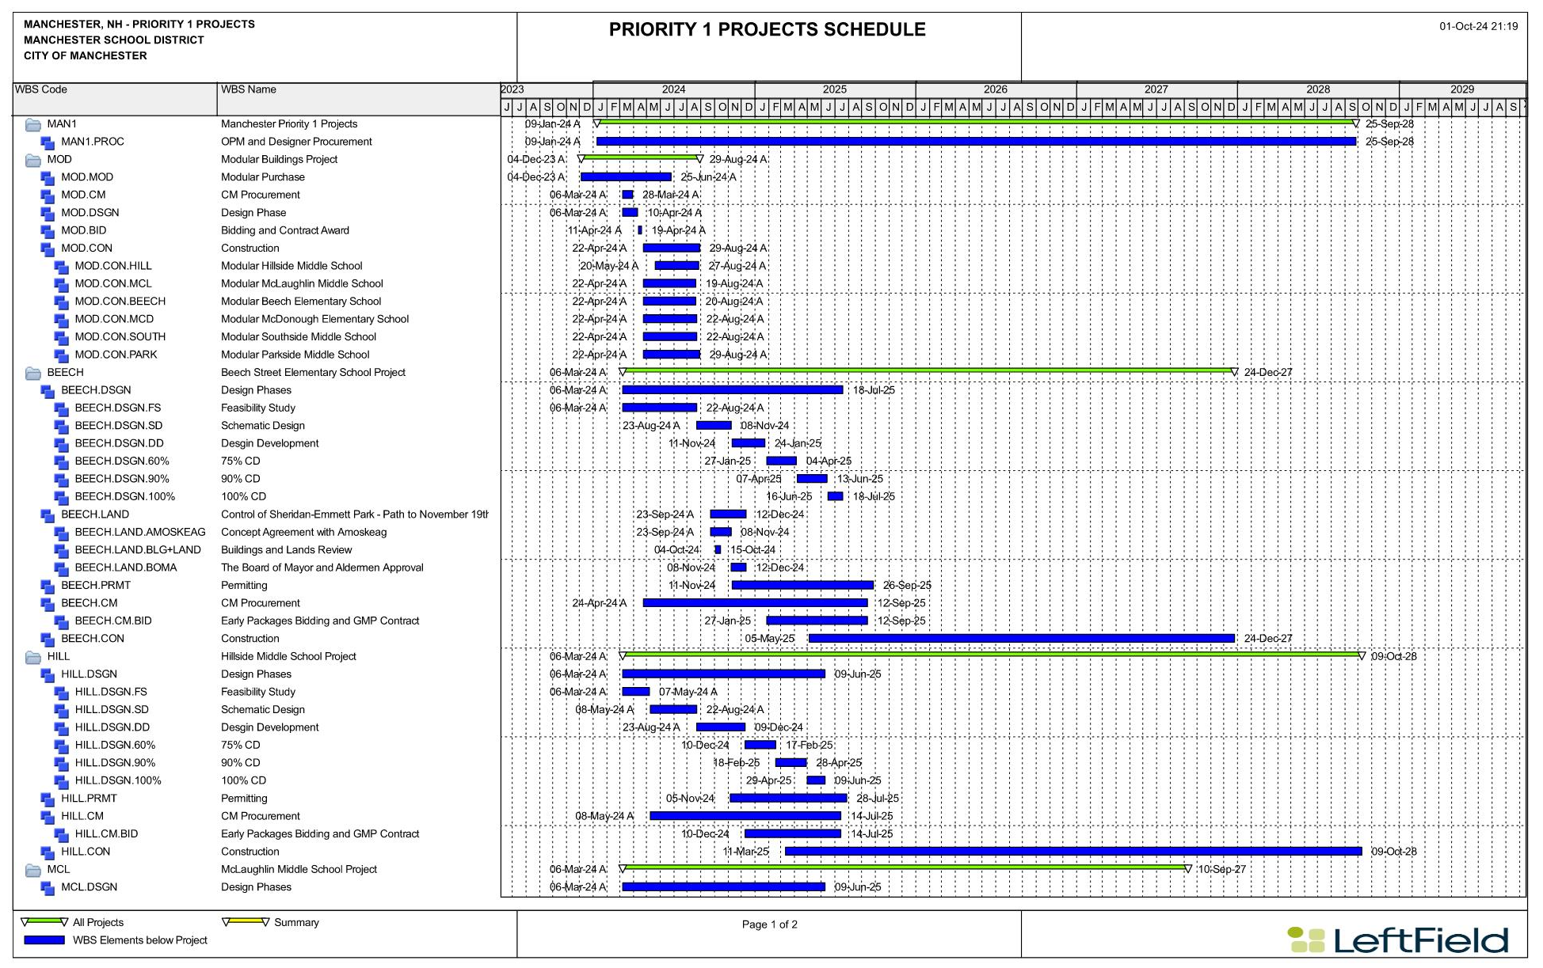
SCHEDULE
Notes:
Lynn’s slide

Slide 10

THANK YOU!
QUESTIONS & ANSWERS

