Slide 1

01
02
03
04
05
06
07
PROGRESS UPDATE
LOOK AHEAD ACTIVITIES
BEECH – COMMISSARY KITCHEN
PROGRESS CHART
BUDGET & INVOICING
SCHEDULE
Q&A
JSBC Meeting
November 12, 2024
TONIGHTS AGENDA
Notes:
David’s slide

Slide 2
Activities completed within the last 30-days
Continued modular punch list
Closeout of Consigli Mod contract (binders received)
Closeout of Triumph Modular contract (binders received)
Coordination and installation of technology
CM contract for Group 1 in progress [Consigli]
CM contract for Group 2 in progress [Harvey]
CM contract Beech in progress [Harvey]
Pre-construction mtgs for Group 1
Pre-construction mtgs for Beech
Continued development of the various Project schedules
Estimate reconciliation for Group 1 projects
Estimate reconciliation for Beech
Continued Beech Elementary programming
Attendance at Lands & Building Committee Mtg.
10-18 School Board Mtg. – Commissary Kitchen
Procurement of website implementation
Continued communication with all stakeholders
30-Day Look-Ahead
Complete modular punch list
MEP Training for modular equipment
Continued closeout of Consigli for Mod contract
Continued closeout of Triumph Modular contract
Execute CM contract for Group 1 [Consigli]
Execute CM contract for Group 2 [Harvey]
Execute CM contract for Beech [Harvey]
Continued pre-construction mtgs for Group 1 and Beech Street projects
Continued development of the various Project schedules and coordination of construction phasing for Hillside & McLaughlin [Group 1]
Progression into construction documents for Hillside & McLaughlin
Continued Beech Street budget refinement
Attendance to Lands & Building Committee Mtg. - Amoskeag deed release
Development of P1 website
Continued communication with all stakeholders
Survey of culvert at Sheridan-Emmett Park
PROJECT PROGRESS
Notes:
Lynn’s slide

Slide 3
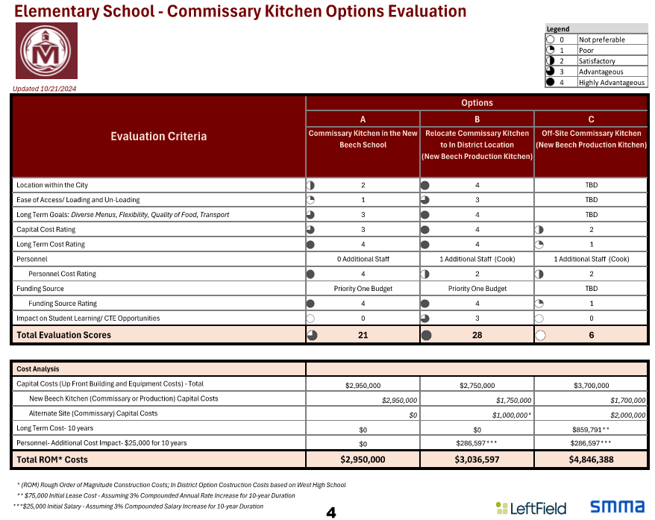
Beech – Commissary Kitchen
Notes:
Lynn’s slide

Slide 4
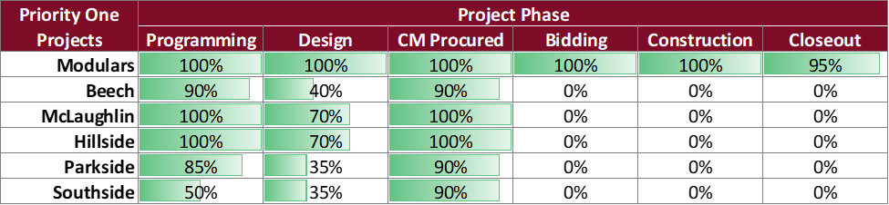
PROGRESS UPDATE
Priority 1 Projects | Update Summary
Notes:
Lynn’s slide

Slide 5
PROGRESS UPDATE
Modulars Summary Update
The punch list is 96% complete and will continue over the next month. Additionally, there may be some punch list scope that will be addressed during winter break
Notes:
Lynn’s slide

Slide 6
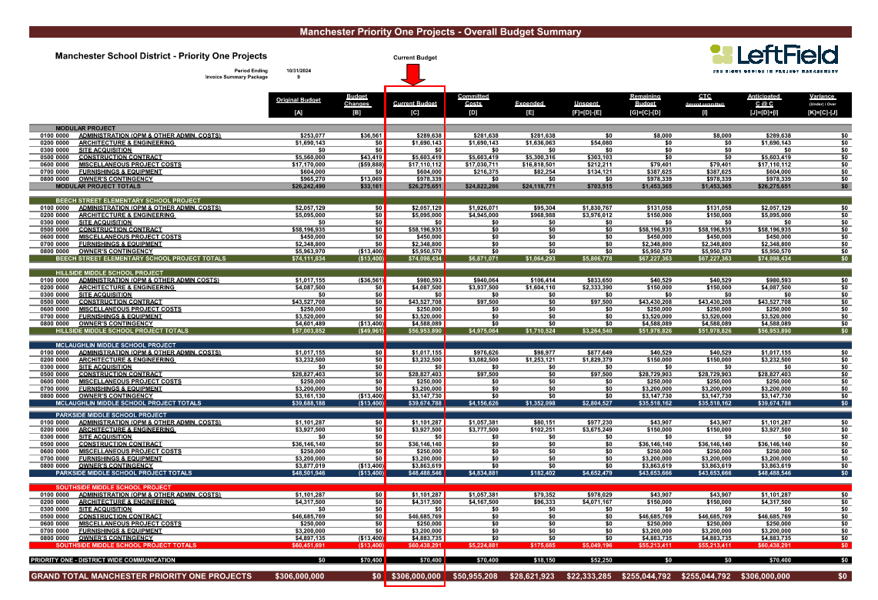
BUDGET STATUS
Notes:
Lynn’s slide

Slide 7
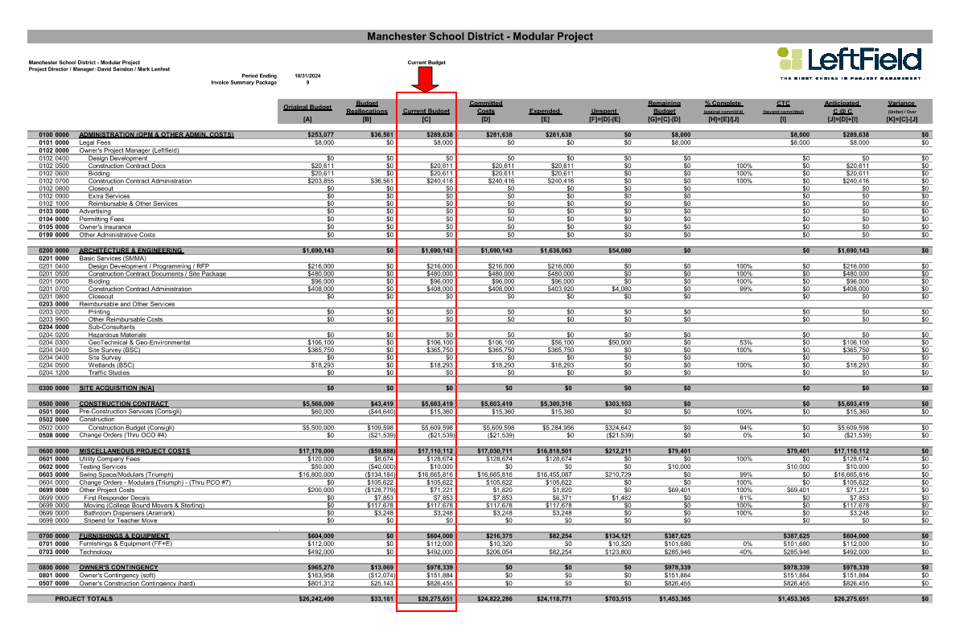
BUDGET STATUS – MOD PROJECT
Notes:
Lynn’s slide

Slide 8
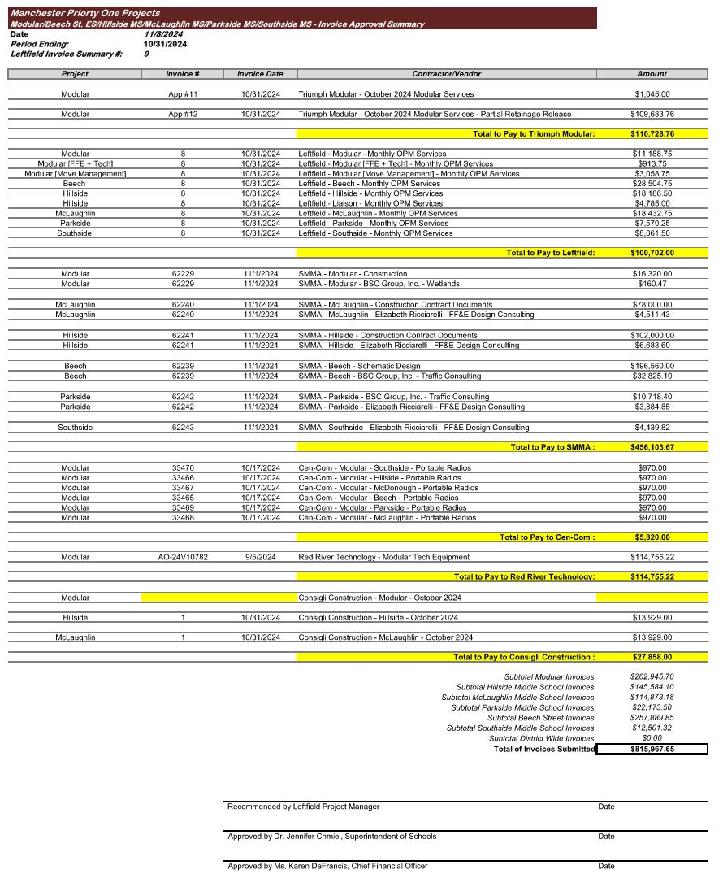
The invoice payment log is scheduled for District approval on November 15th and payment approval on November 21st, with the payment check date for November 22nd.
The invoice log presented here was approved by the District on November 8, 2024.
INVOICE UPDATE
Notes:
Lynn’s slide

Slide 9
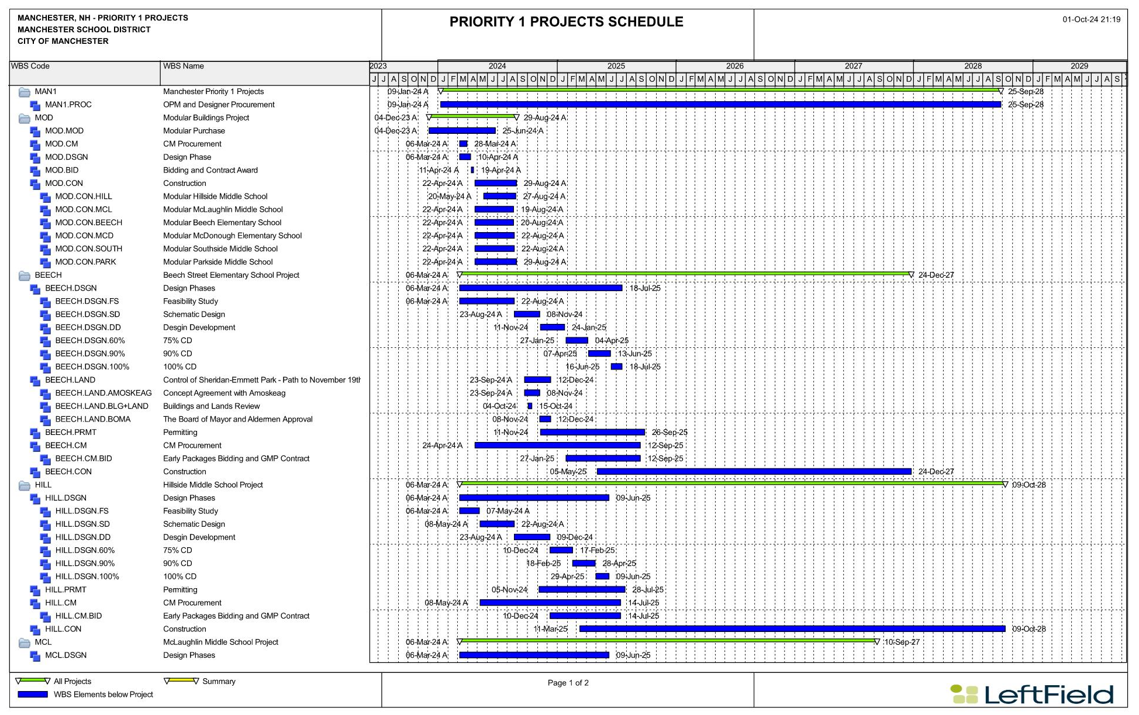
SCHEDULE
Notes:
Lynn’s slide

Slide 10

THANK YOU!
QUESTIONS & ANSWERS

